Slide 1




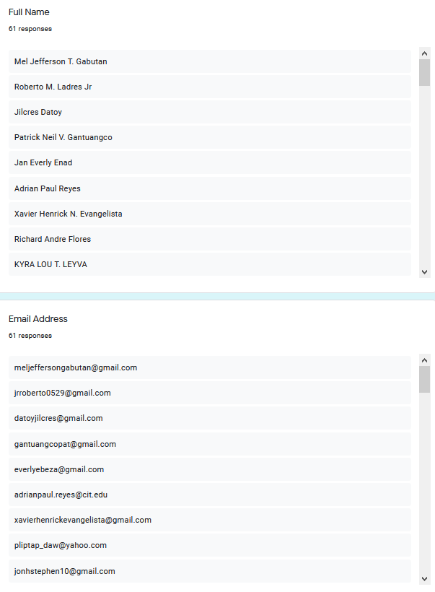




PAD
LOGO

Slide 2







SURVEY RESULTS
Number of respondents
Email address in ani xD
PRIVATE
PRIVATE

Slide 3
SURVEY RESULTS
Interface Design Uniqueness
The logo matches the functionality of the application
Graph kato pariah ila Ada
Graph kato pariah ila Ada
How does the color scheme and contrast look to you?
Readability of the characters on the screen
Graph kato pariah ila Ada
Graph kato pariah ila Ada

Slide 4
SURVEY RESULTS
Icons are understandable as to what it does.
Information Organization
Graph kato pariah ila Ada
Graph kato pariah ila Ada
Font Style is appropriate and catchy.
Icons, texts and design layout positioning
Graph kato pariah ila Ada
Graph kato pariah ila Ada

Slide 5
SURVEY RESULTS
Login Page
Dashboard Design
Graph kato pariah ila Ada
Graph kato pariah ila Ada
Edited Documents can be easily found in one place in the application
Overall look and feel of the application.
Graph kato pariah ila Ada
Graph kato pariah ila Ada

Slide 6
SURVEY RESULTS
Is the application easy to use?
Would you recommend us to a friend or a colleague?
Graph kato pariah ila Ada
Graph kato pariah ila Ada

Slide 7
SURVEY RESULTS
Suggestion
Comments
Image
image

Slide 8

PAD’S USER INTERFACE
Katong pictures na gi butang sa google form

Slide 9
THE TEAM
GABUTAN, MEL
WA KO KAILA

Slide 10
THE TEAM
DURAN, HANS
FEROLINO, JOHN
DATOY, JILCRES
ENGBINO, KAYE

